Slide 1
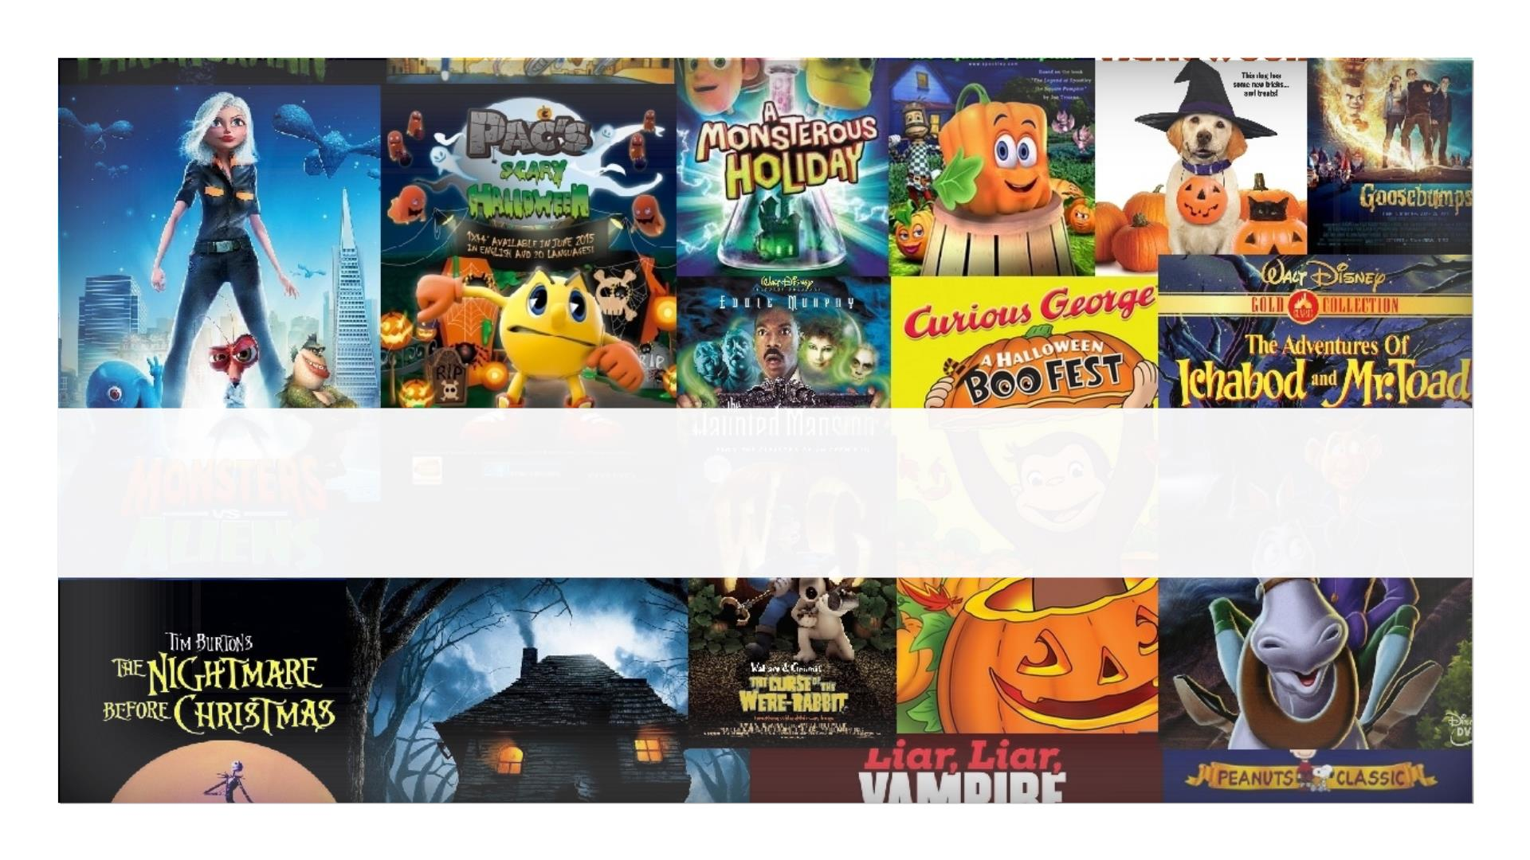
Reel Booking

Slide 2
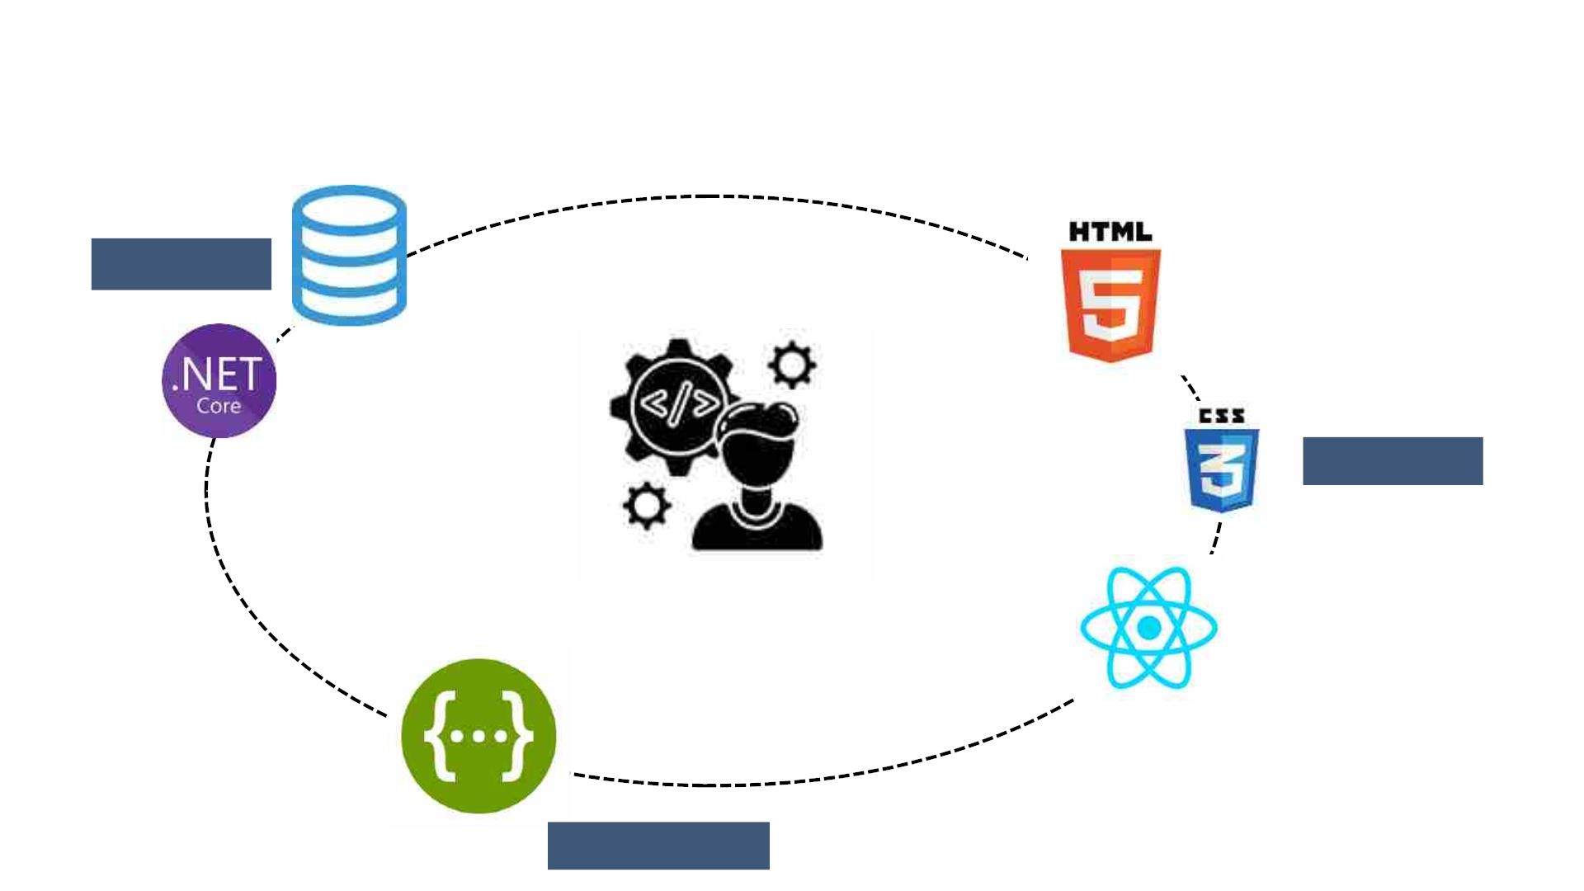
technologY stacK
BACKEND
Database
FRONTEND
React
Swagger
3
MIDDLEWARE

Slide 3
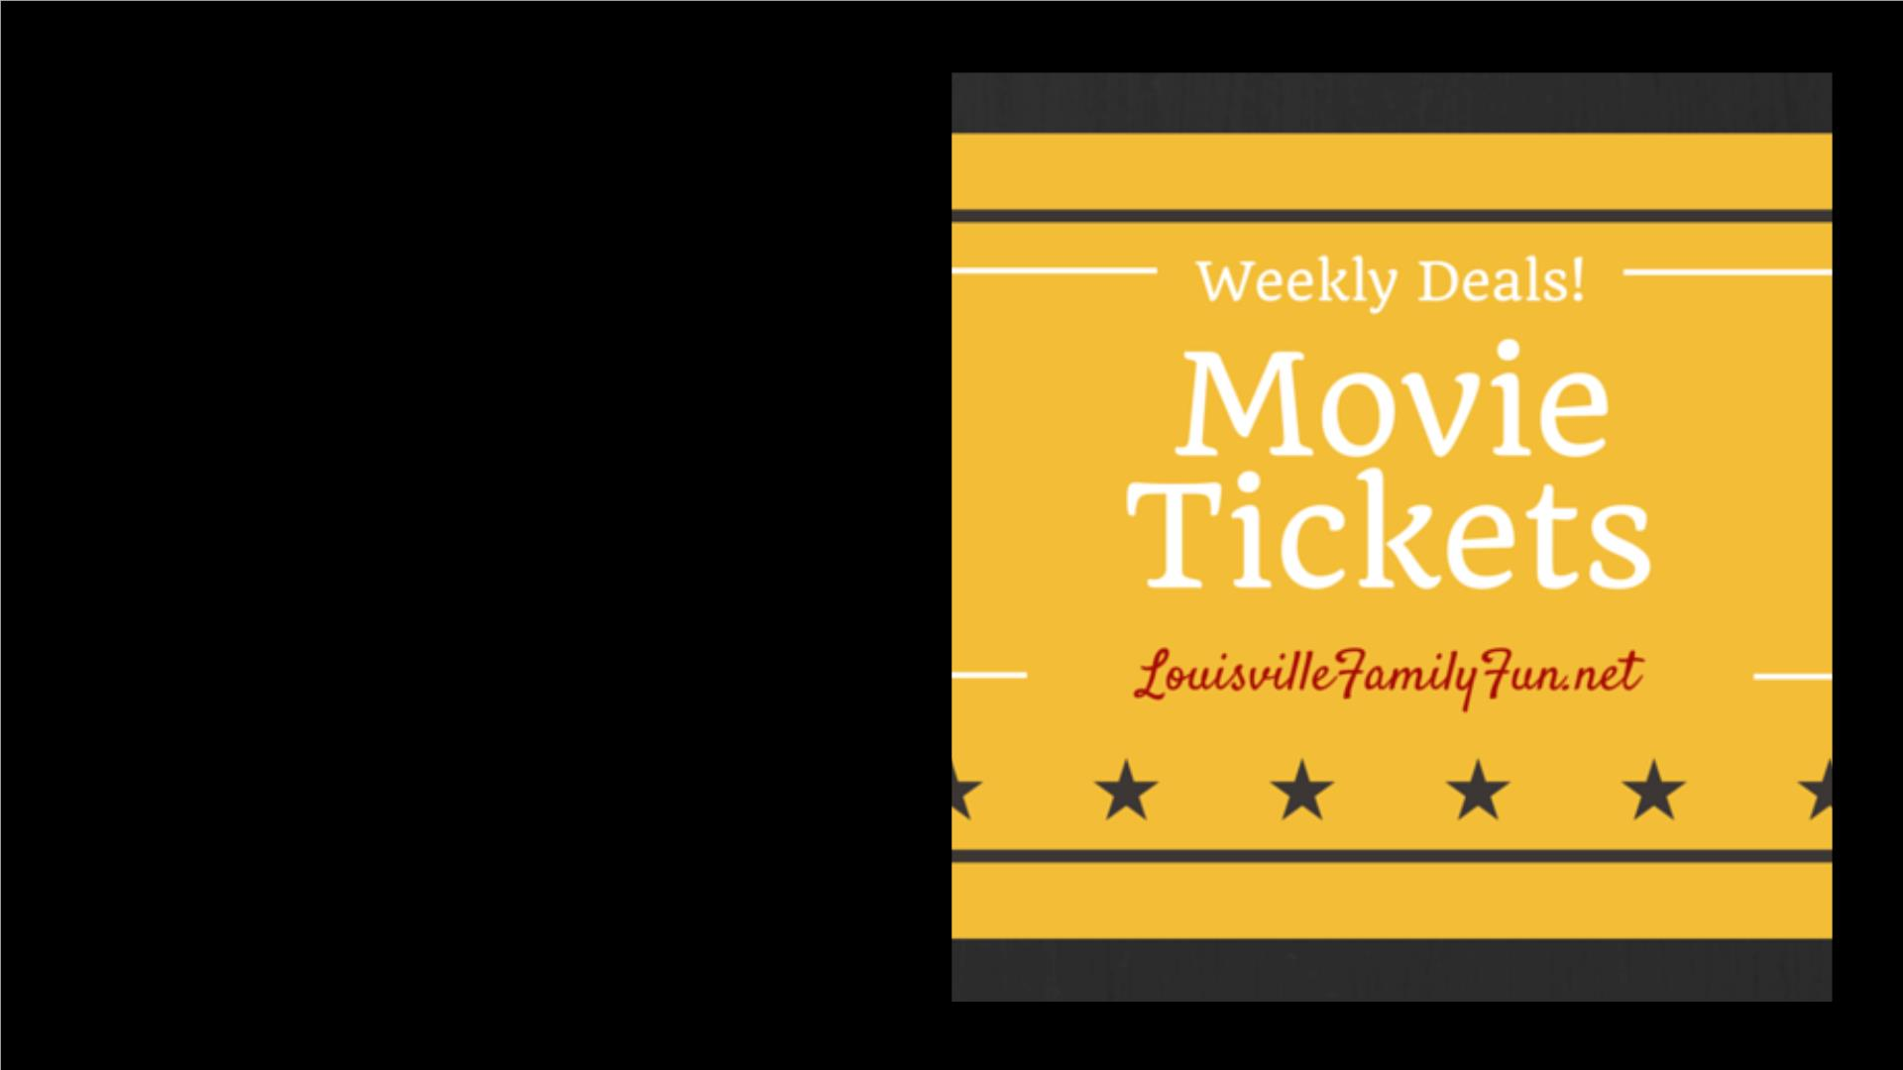
q Purpose
• Reel Booking App is a “Movie
Ticket Booking System”.
• It is based on the Web application
which is developed in C#.NET to
facilitate the booking for movie
tickets.
• The system includes features such
as movie listing, seat selection
and reservation management.nd
user authentication.
3/7/2024
4
ADD A FOOTER

Slide 4
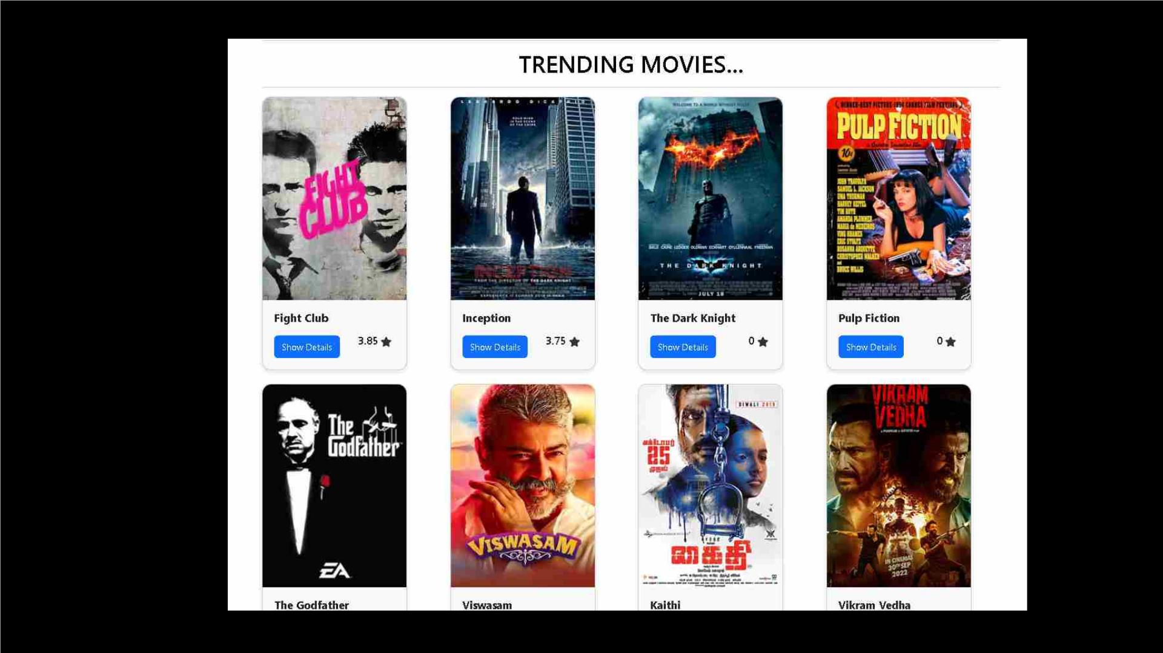
ui
• user auth
5

Slide 5
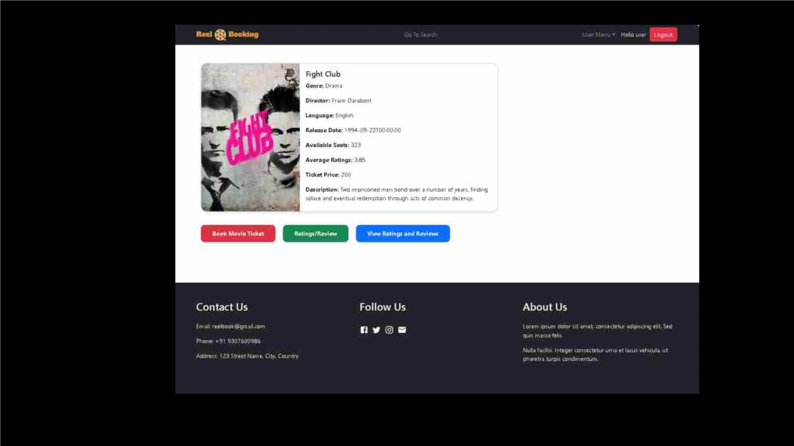
ui
• user authe
6

Slide 6
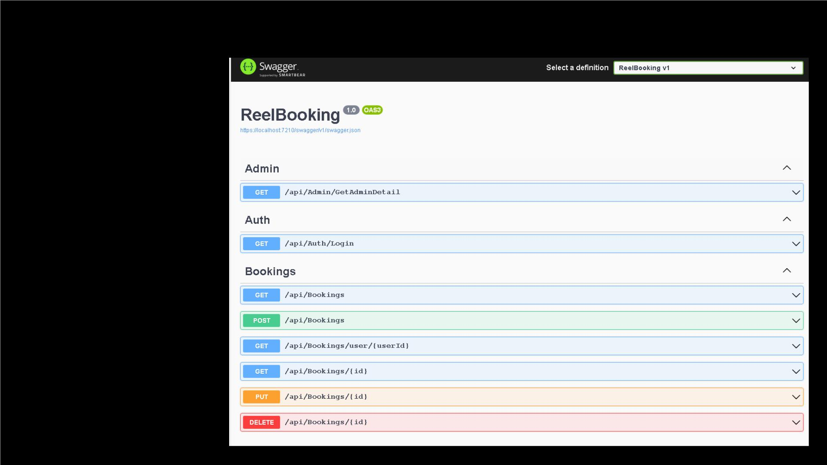
sWagger
• user authentica
7

Slide 7

q Modules
-- Admin
-- User
--Theater Manager
8

Slide 8

Login
Search
Users and
Theater
View
bookings
of Users
admin
functionalities
Manager
Admin
Approve/
Reject
Theater
Manager
Search
Movies
View
history of
User and
Theater
Manager

Slide 9

Register
Delete
Movies
theater
Login
manager
functionalities
Theater
Manager
Search
Movies
Insert
Movie
Update
Movie
Details

Slide 10

Register
and Login
View and
Give
Ratings and
Reviews
Update
Profile
Details
user
functionalities
User
Receive
Bonus
Search
and View
Movie
points on
every
Details
booking
Book
Tickets

Slide 11
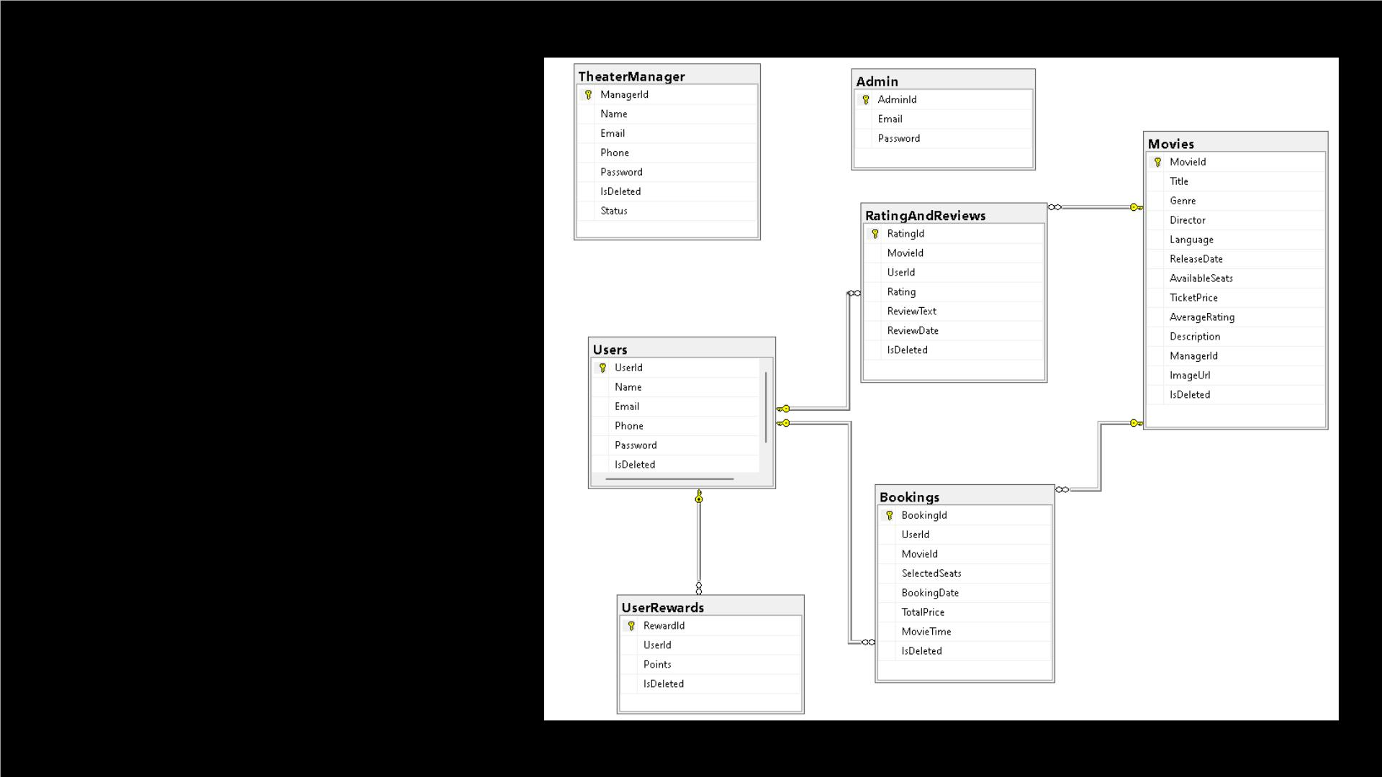
er diagram

Slide 12
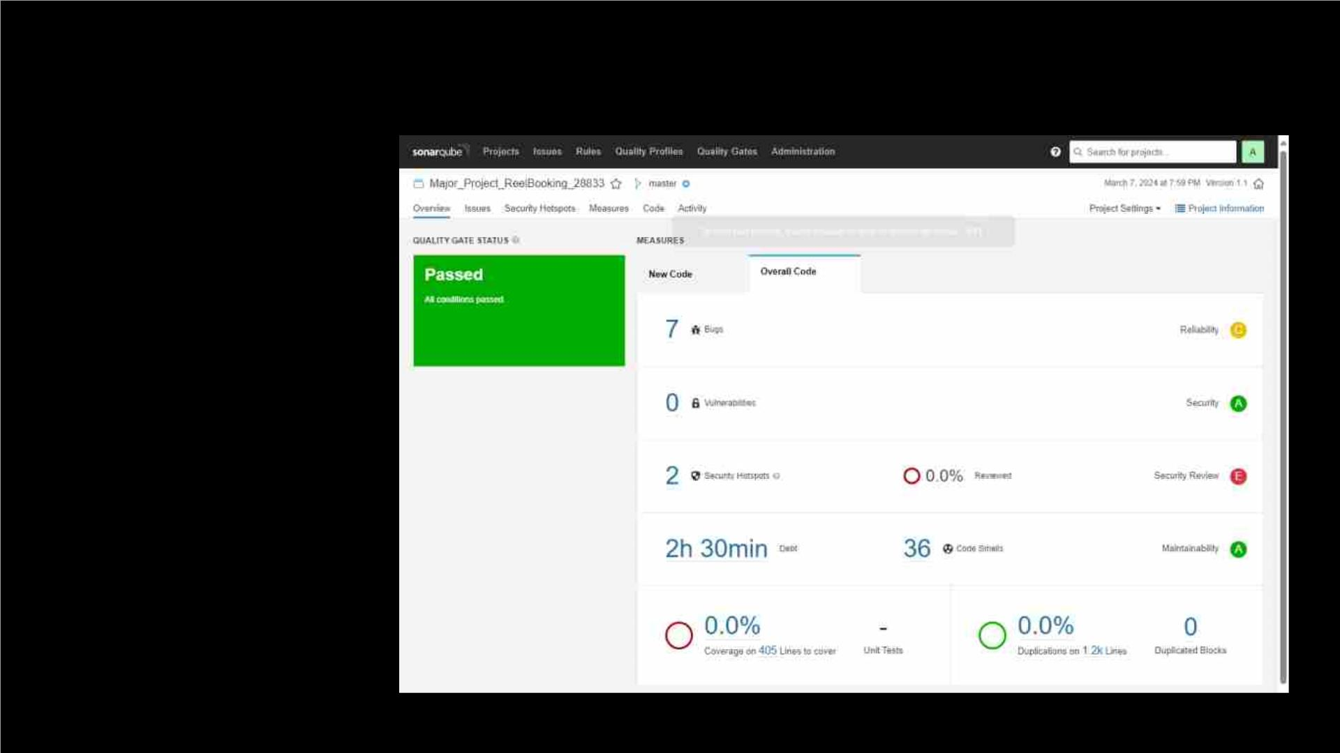
sonarqube report

Slide 13
Thank You!

